Slide 1
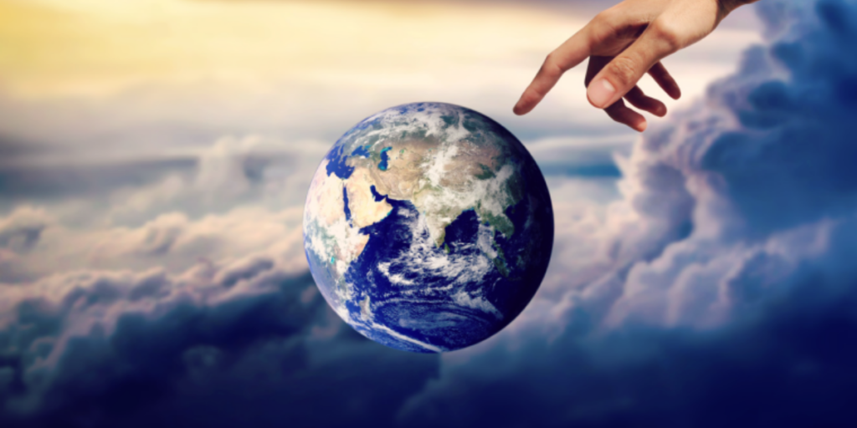
St. Thomas Aquinas’ Fifth proof of the existence of God
The Way of Design: The manifestation of order and lawfulness in the universe
You can see beauty, immensity, symmetry, and power in our world that forces us to conclude that a Grand Designer made it all.

Slide 2
What is the Role of Water in Sacred Scripture and Tradition?

Slide 3
Number of times water is mentioned in the bible
722
More often than faith, hope, prayer, and worship

Slide 4
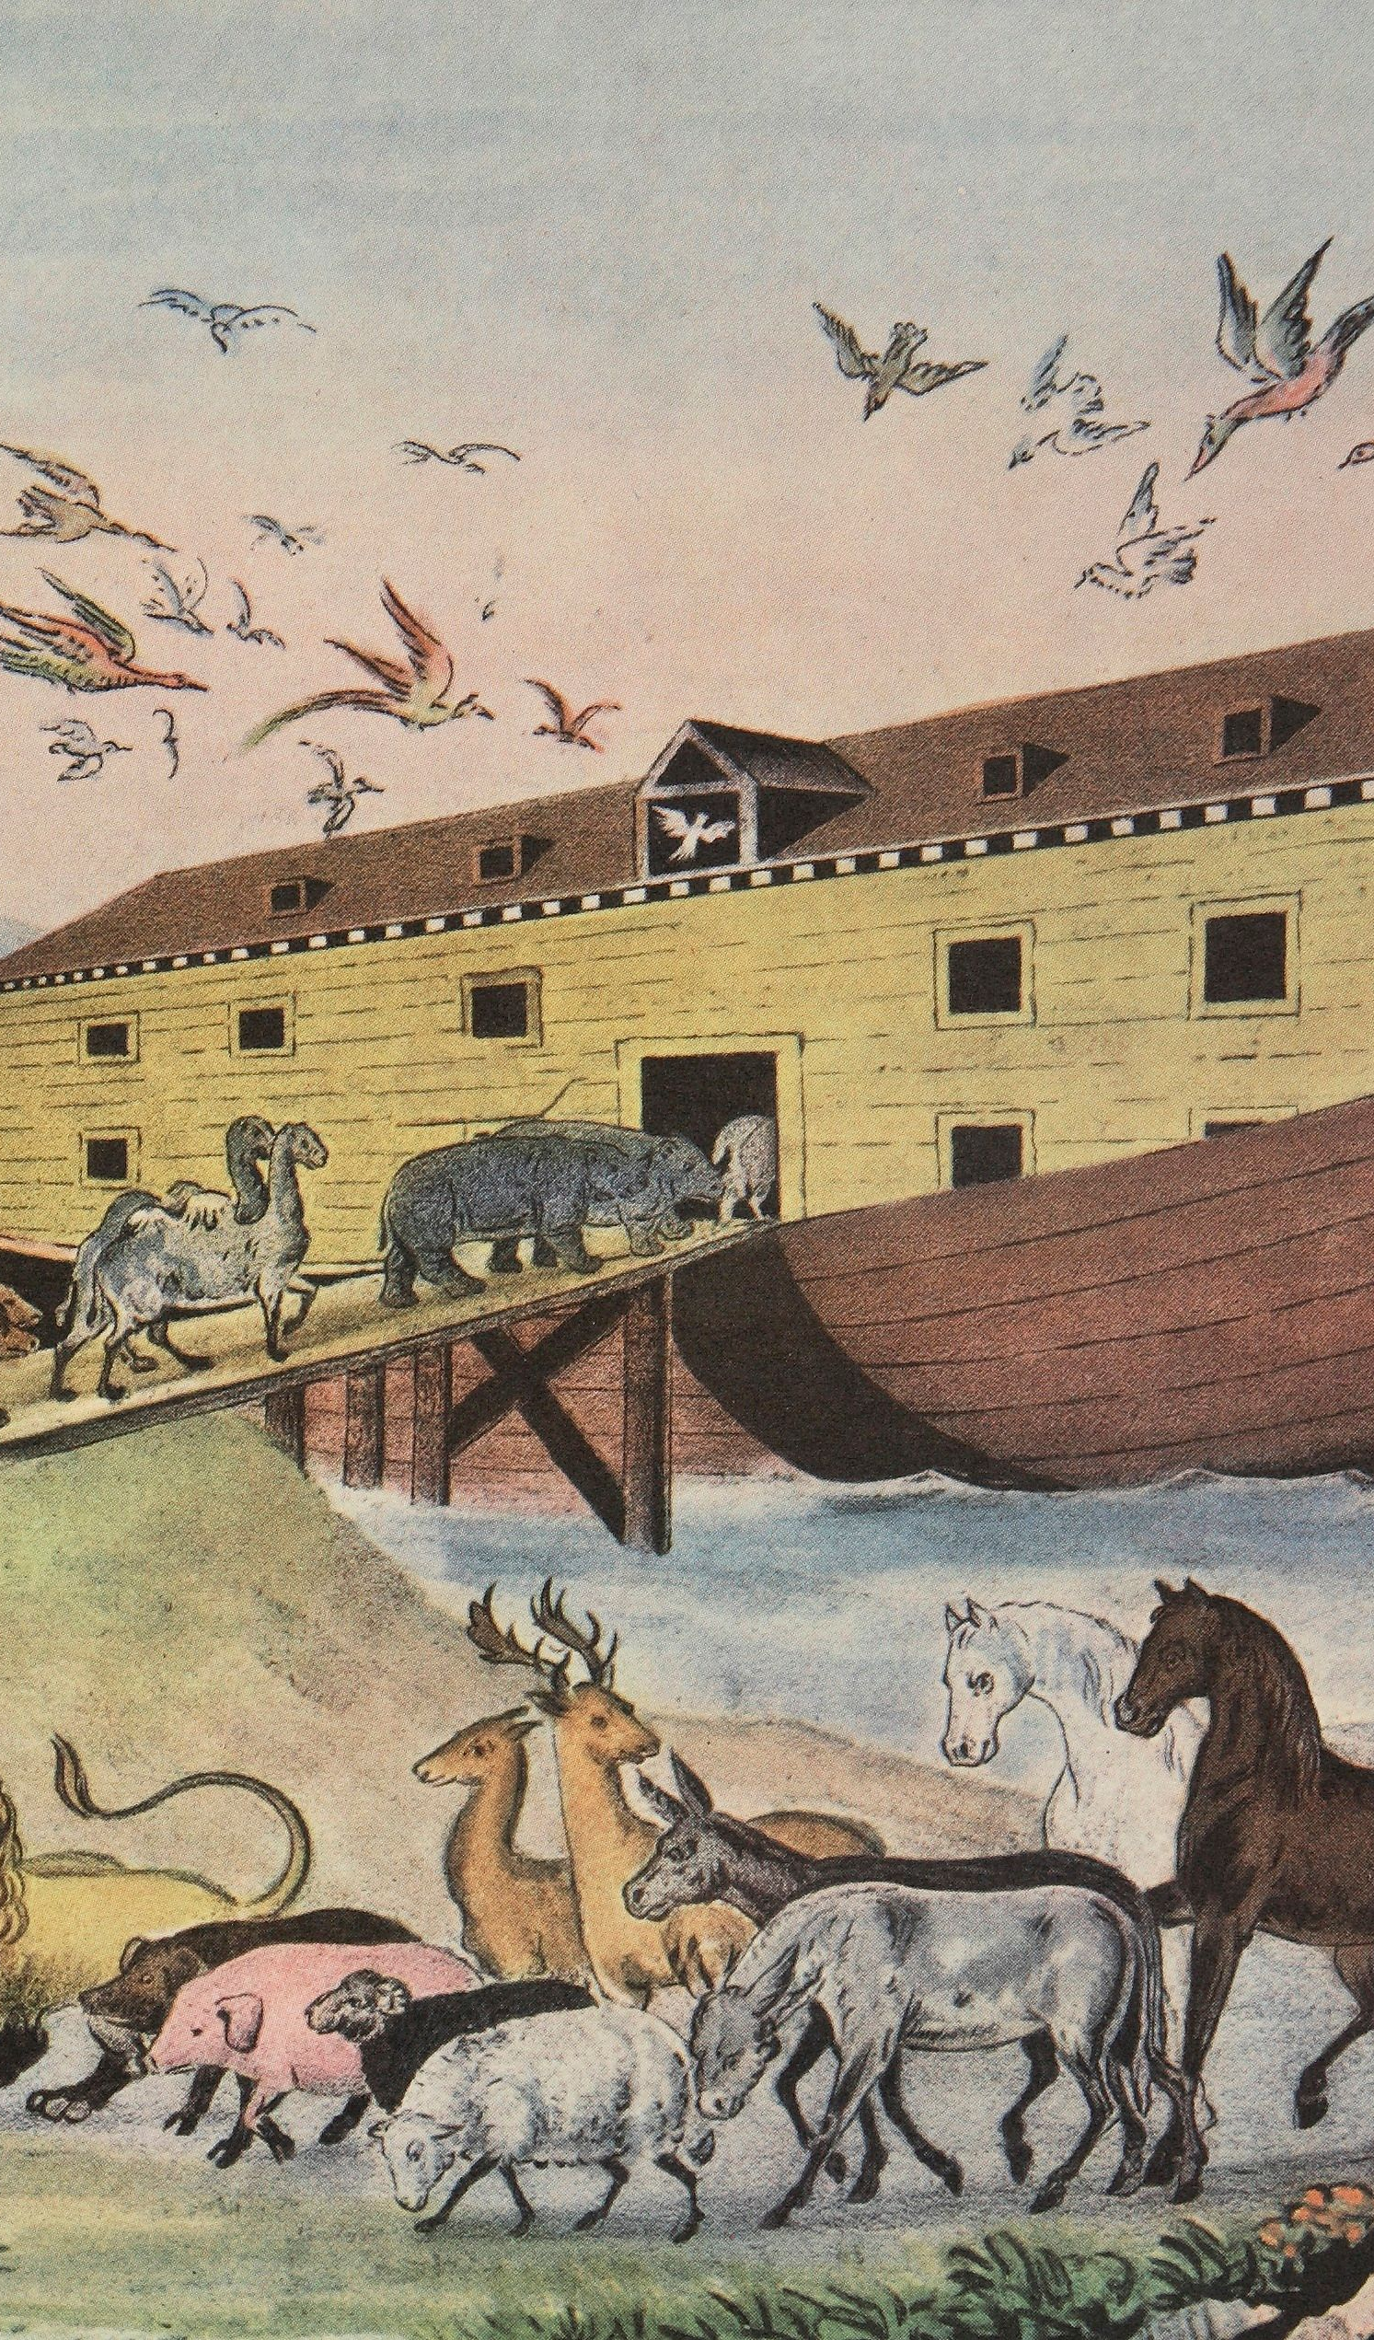
The Flood and God’s promise to Noah (Genesis 8:1-5)
8 But God remembered Noah and all the beasts and all the cattle that were with him in the ark. And God made a wind blow over the earth, and the waters subsided; 2 the fountains of the deep and the windows of the heavens were closed, the rain from the heavens was restrained, 3 and the waters receded from the earth continually. At the end of a hundred and fifty days the waters had abated; 4 and in the seventh month, on the seventeenth day of the month, the ark came to rest upon the mountains of Ar′arat. 5 And the waters continued to abate until the tenth month; in the tenth month, on the first day of the month, the tops of the mountains were seen.

Slide 5
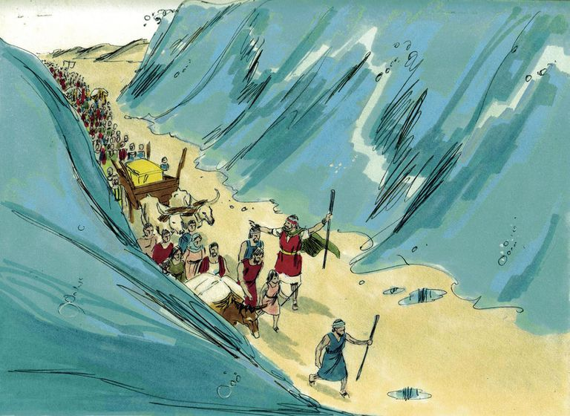
Freedom from exile: parting the red sea (exodus 14: 26-29)
²⁶ Then the Lord said to Moses, “Stretch out your hand over the sea, that the water may come back upon the Egyptians, upon their chariots, and upon their horsemen.” ²⁷ So Moses stretched forth his hand over the sea, and the sea returned to its wonted flow when the morning appeared; and the Egyptians fled into it, and the Lord routed^{[c]} the Egyptians in the midst of the sea. ²⁸ The waters returned and covered the chariots and the horsemen and all the host^{[d]} of Pharaoh that had followed them into the sea; not so much as one of them remained. ²⁹ But the people of Israel walked on dry ground through the sea, the waters being a wall to them on their right hand and on their left.

Slide 6
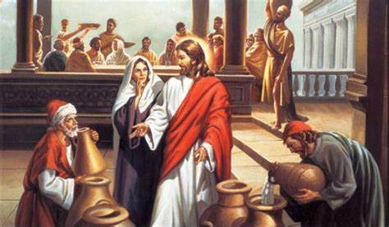
Jesus’ First Miracle
Wedding feast at Cana (John 2):
Water to Wine
1 On the third day there was a marriage at Cana in Galilee, and the mother of Jesus was there; 2 Jesus also was invited to the marriage, with his disciples. 3 When the wine failed, the mother of Jesus said to him, “They have no wine.” 4 And Jesus said to her, “O woman, what have you to do with me?[a] My hour has not yet come.” 5 His mother said to the servants, “Do whatever he tells you.” 6 Now six stone jars were standing there, for the Jewish rites of purification, each holding twenty or thirty gallons. 7 Jesus said to them, “Fill the jars with water.” And they filled them up to the brim. 8 He said to them, “Now draw some out, and take it to the steward of the feast.” So they took it. 9 When the steward of the feast tasted the water now become wine, and did not know where it came from (though the servants who had drawn the water knew), the steward of the feast called the bridegroom 10 and said to him, “Every man serves the good wine first; and when men have drunk freely, then the poor wine; but you have kept the good wine until now.” 11 This, the first of his signs, Jesus did at Cana in Galilee, and manifested his glory; and his disciples believed in him.

Slide 7
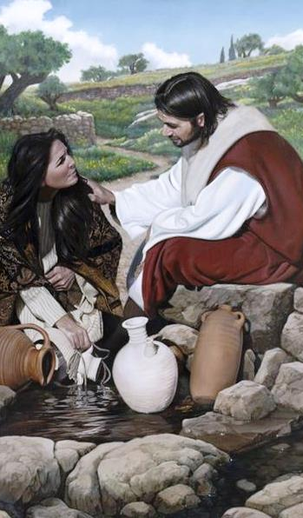
Jesus AND THE WATERS OF ETERNAL LIFE: Woman at the Well (JOHN 4)
7 There came a woman of Samar′ia to draw water. Jesus said to her, “Give me a drink.” 8 For his disciples had gone away into the city to buy food. 9 The Samaritan woman said to him, “How is it that you, a Jew, ask a drink of me, a woman of Samar′ia?” For Jews have no dealings with Samaritans. 10 Jesus answered her, “If you knew the gift of God, and who it is that is saying to you, ‘Give me a drink,’ you would have asked him, and he would have given you living water.” …13 Jesus said to her, “Everyone who drinks of this water will thirst again, 14 but whoever drinks of the water that I shall give him will never thirst; the water that I shall give him will become in him a spring of water welling up to eternal life.” 15 The woman said to him, “Sir, give me this water, that I may not thirst, nor come here to draw.”

Slide 8
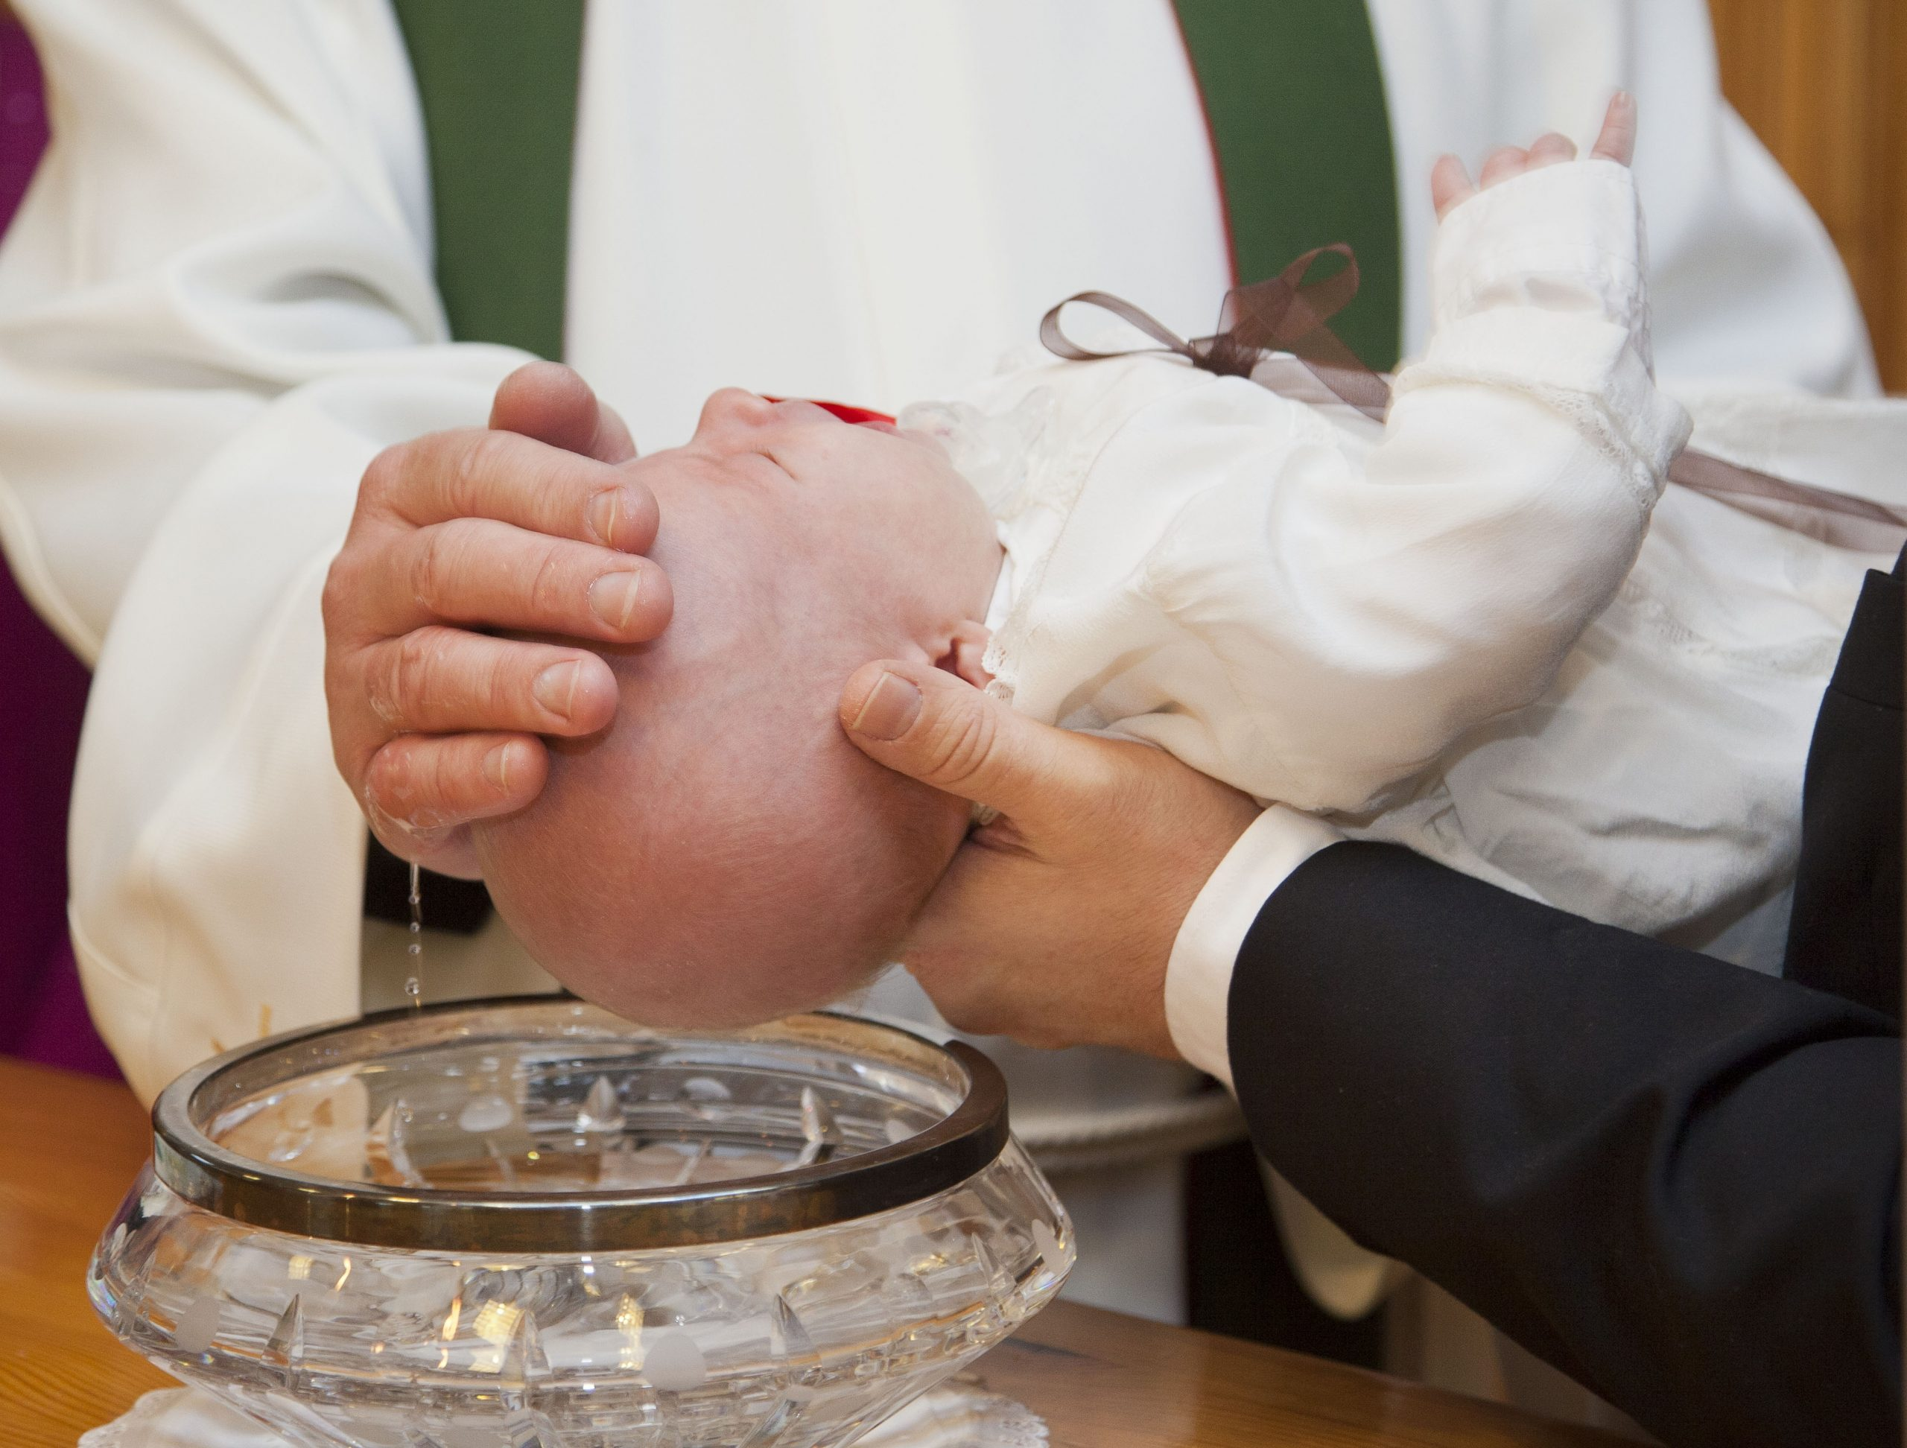
The Sacrament of Baptism
Although water is normally poured over a baby’s head, at the Easter Vigil adults are baptized as they stand inside of a pool. They usually get so soaked that they have to change their clothes and return to the church for the rest of the baptismal ritual! Our Catholic faith is rich with signs and symbols. We baptize with water, which is a powerful symbol of new life and renewal (CCC, no. 1234). The waters of baptism are “the source of that new life in Christ from which the entire Christian life springs forth” (CCC, no. 1254).

